Slide 1
NASA CMS uncertainty working group
Active members (2013-2014): Chris Badurek, David Baker, Nicolas Bousserez, Jim Collatz, Riley Duren, Sangram Ganguly, Stephen Hagen, Robert Kennedy, Dimitris Menemenlis, John Miller, Steve Pawson

Slide 2
Short story
What we did: Uncertainty framework Definitions and documentation
What we’re trying to do now: Integration Comparison across projects
We need your help

Slide 3
If we were all talking about the same thing, then we could put all of our results together and everything should overlap!
Observation
What is uncertainty here?
Model
Map of state or flux
Data
Propagation
Map 2 of state or flux
Notes:
The basic notion: We are making estimates at locations where we have no observations.

Slide 4
Types of uncertainty

Slide 5
3. Model-data comparison
1. Deterministic
2. Stochastic/Ensemble
4. Model-model comparison
Models and data are both wrong
Models are correct – errors come from measurements and the initial guess of the state.
5. Data-Data comparison

Slide 6
* Numbers correspond to project IDs in briefing material appendix

Slide 7
Are uncertainty estimates from CMS projects
CONSISTENT &
RELEVANT?

Slide 8
Resolving Uncertainty
Ideal: Quantify and map agreement among products
Reality? Voluntary comparisons on pairwise project basis
Now: Visual comparisons!

Slide 9
Biomass products

Slide 10
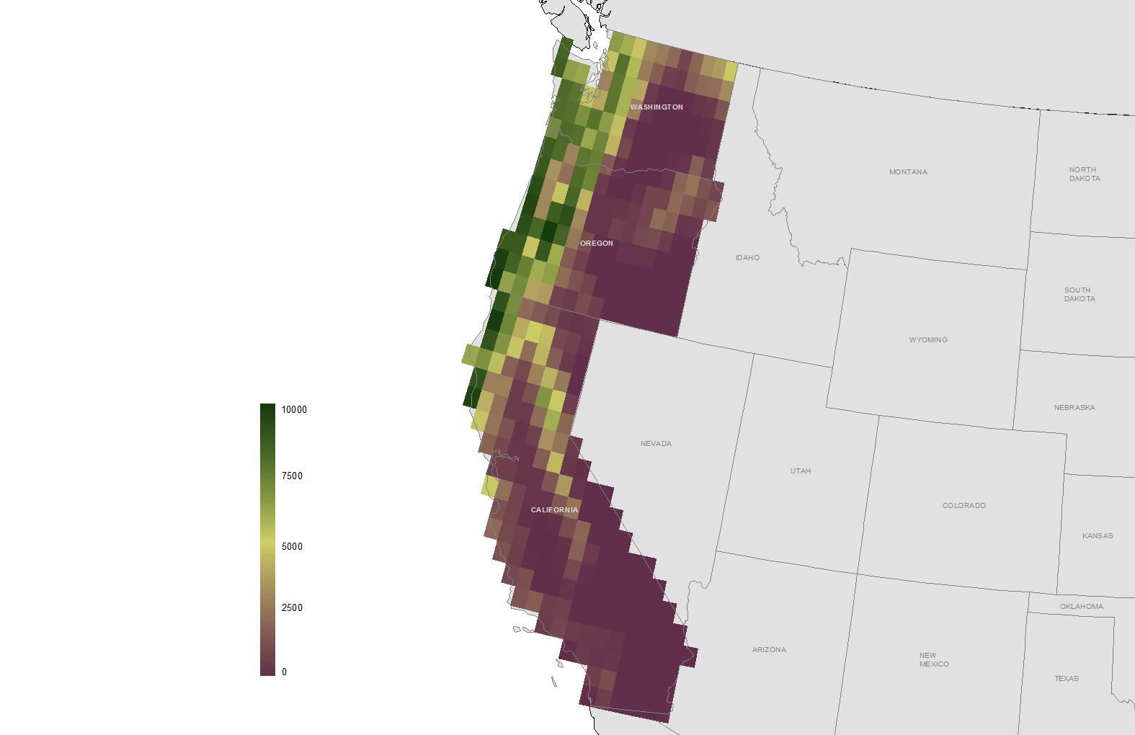
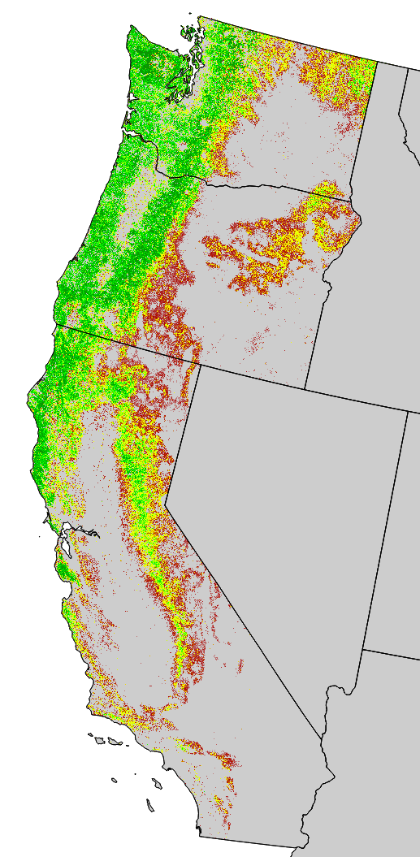
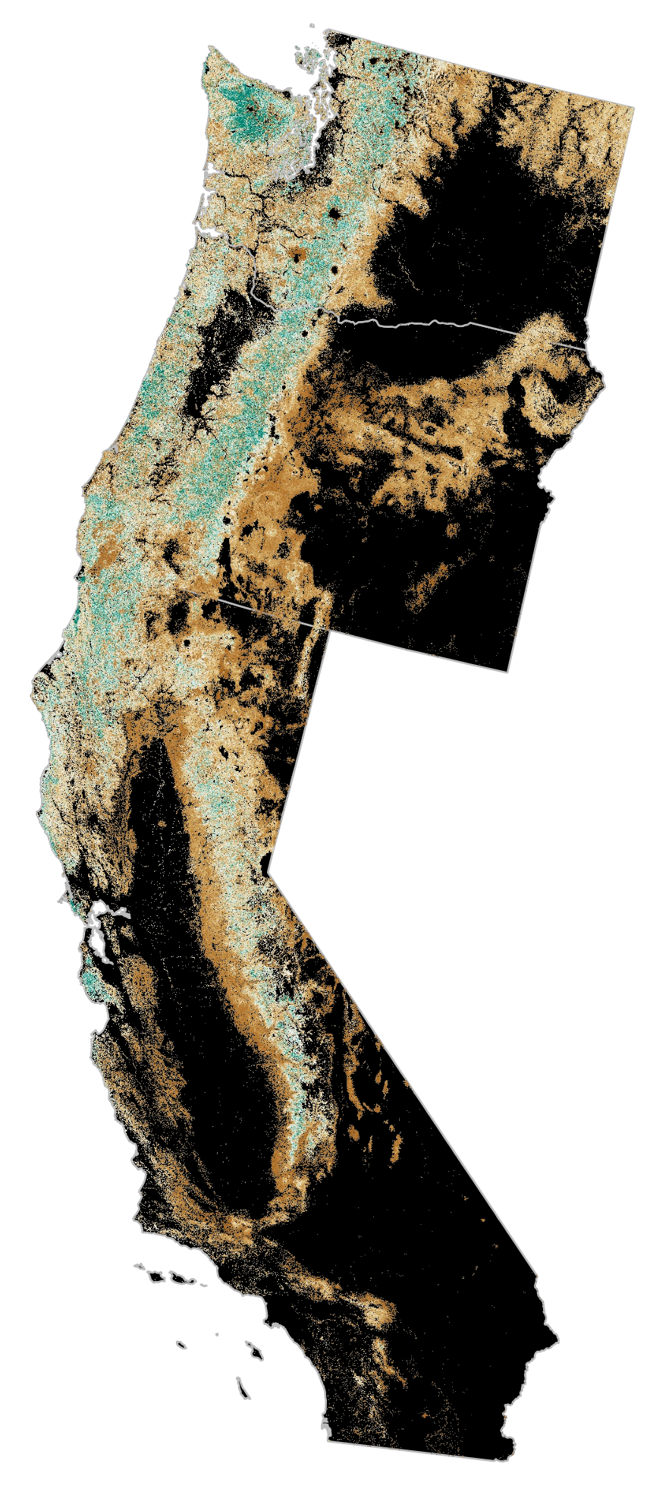
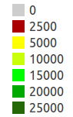

Aboveground biomass: 2005
10,000
0
0
27,000+
Jim Collatz
Stephen Hagen
Robert Kennedy

Slide 11
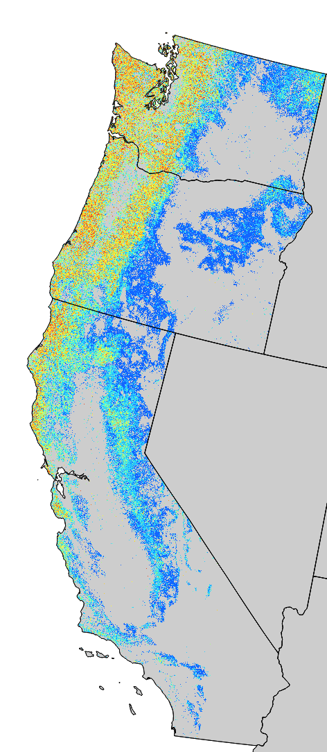
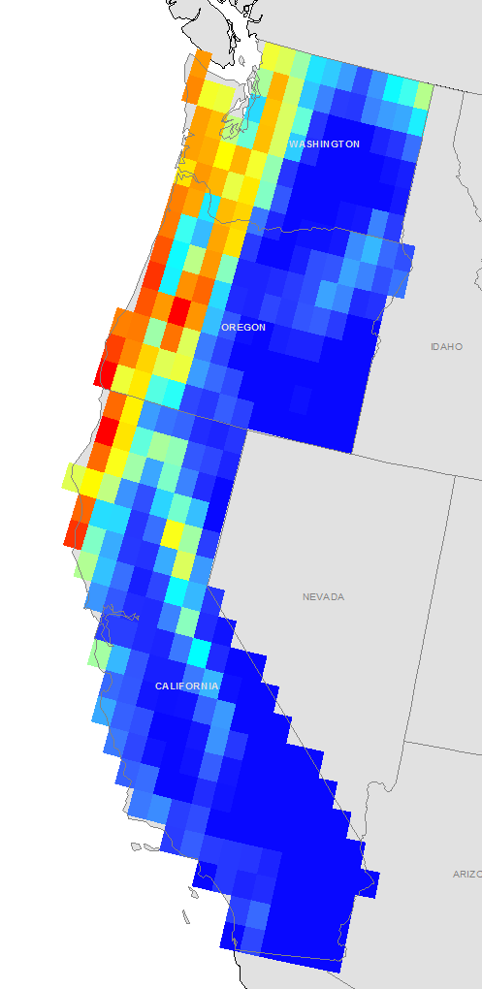
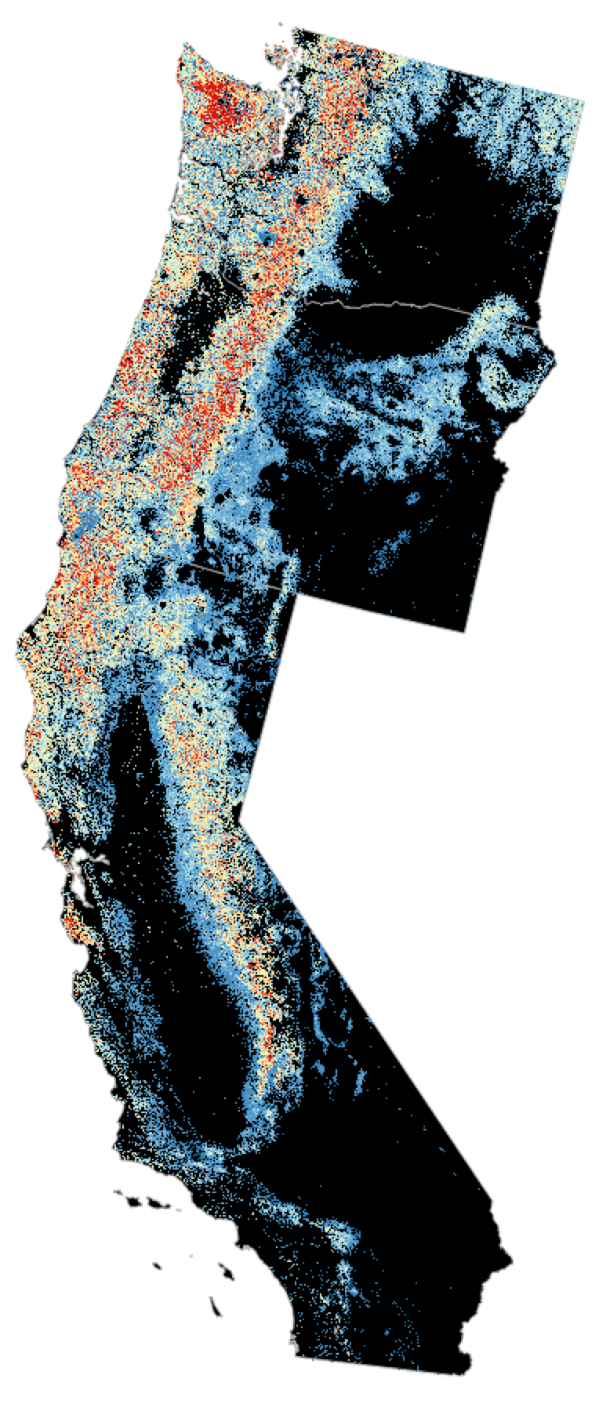
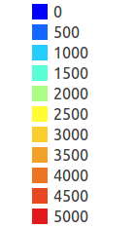
Uncertainty
g C / m²

Slide 12
Flux products

Slide 13
David Baker
A priori monthly flux uncertainty
Variational Data Assimilation:
GOSAT X_{CO2} measurements
OSSE experiment, PCTM transport
Variational data assimilation method
Measurement uncertainties (1σ):
  1.0 ppm, ocean glint
  1.5 ppm, M-gain land
  1.7 ppm, H-gain land
A posteriori monthly flux uncertainty

Slide 14
Junjie Liu
Variational Data Assimilation:
GOSAT X_{CO2} measurements
OSSE experiment, GEOS-Chem transport
Variational data assimilation method
Measurement uncertainties (1σ):
  Actual GOSAT Xco2 (H-gain land observations only) observation errors (between 1 ppm and 2.5 ppm)
Uncertainty calculation method
  60 ensemble member Monte-Carlo method

Slide 15
Fractional error reduction
  The mean error reduction at each grid point is calculated as:

Slide 16
Working group breakout
Identify linkages where projects could compare uncertainty products
Document what data prep is needed
to achieve comparisons
Begin identifying approaches to assess consistency and relevance

